Slide 1
Chapter 1
Introduction

Slide 2
Algorithm
An Algorithm is a sequence of unambiguous instructions for solving a problem,
i.e., for obtaining a required output for any legitimate input in a finite amount of time.

Slide 3
Notion of algorithm
problem
algorithm
“computer”
input
output
Algorithmic solution

Slide 4
PSEUDOCODE
Pseudocode (pronounced SOO-doh-kohd) is a detailed yet readable description of what a computer program or algorithm must do, expressed in a formally-styled natural language rather than in a programming language.
It is sometimes used as a detailed step in the process of developing a program.
It allows programmers to express the design in great detail and provides programmers a detailed template for the next step of writing code in a specific programming language.

Slide 5
Formatting and Conventions in Pseudocoding
INDENTATION in pseudocode should be identical to its implementation in a programming language. Try to indent at least four spaces.
The pseudocode entries are to be cryptic, AND SHOULD NOT BE PROSE. NO SENTENCES.
No flower boxes in pseudocode.
Do not include data declarations in pseudocode.

Slide 6
Some Keywords That Should be Used
For looping and selection,
  Do While...EndDo;
  Do Until...Enddo;
  Case...EndCase;
  If...Endif;
  Call ... with (parameters); Call; Return ....; Return; When; Always use scope terminators for loops and iteration.

Slide 7
Some Keywords …
As verbs, use the words
  generate, Compute, Process,
  Set, reset,
  increment,
  calculate,
  add, sum, multiply, ...
  print, display,
  input, output, edit, test , etc.

Slide 8
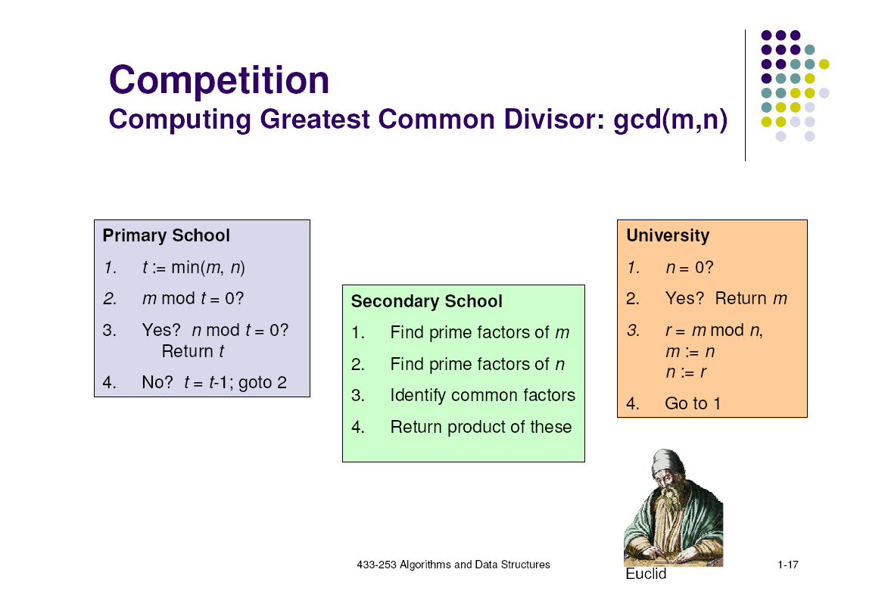
Methods of finding GCD
M - 1
M - 3
M - 2

Slide 9
Euclid’s Algorithm
Problem: Find gcd(m,n), the greatest common divisor of two nonnegative, not both zero integers m and n
Examples: gcd(60,24) = 12, gcd(60,0) = 60, gcd(0,0) = ?
Euclid’s algorithm is based on repeated application of equality
gcd(m,n) = gcd(n, m mod n)
until the second number becomes 0, which makes the problem
trivial.
Example: gcd(60,24) = gcd(24,12) = gcd(12,0) = 12
Notes:
Euclid’s algorithm is good for introducing the notion of an algorithm because it
makes a clear separation from a program that implements the algorithm.
It is also one that is familiar to most students.
Al Khowarizmi (many spellings possible...) – “algorism” (originally) and then
later “algorithm” come from his name.

Slide 10
Two descriptions of Euclid’s algorithm
Step 1 If n = 0, return m and stop; otherwise go to Step 2
Step 2 Divide m by n and assign the value fo the remainder to r
Step 3 Assign the value of n to m and the value of r to n. Go to
Step 1.
while n ≠ 0 do
r ← m mod n
m← n
n ← r
return m

Slide 11
Other methods for computing gcd(m,n)
Consecutive integer checking algorithm
Step 1 Assign the value of min{m,n} to t
Step 2 Divide m by t. If the remainder is 0, go to Step 3;
otherwise, go to Step 4
Step 3 Divide n by t. If the remainder is 0, return t and stop;
otherwise, go to Step 4
Step 4 Decrease t by 1 and go to Step 2

Slide 12
Other methods for gcd(m,n) [cont.]
Middle-school procedure
Step 1 Find the prime factorization of m
Step 2 Find the prime factorization of n
Step 3 Find all the common prime factors
Step 4 Compute the product of all the common prime factors
and return it as gcd(m,n)
Is this an algorithm?

Slide 13
Sieve of Eratosthenes
Input: Integer n ≥ 2
Output: List of primes less than or equal to n
for p ← 2 to n do A[p] ← p
for p ← 2 to ⎣n⎦ do
if A[p] ≠ 0 //p hasn’t been previously eliminated from the list
j ← p* p
while j ≤ n do
A[j] ← 0 //mark element as eliminated
j ← j + p
Example: 2 3 4 5 6 7 8 9 10 11 12 13 14 15 16 17 18 19 20

Slide 14
Termination of Euclid’s Algorithm
The second number of the pair gets smaller with each iteration and cannot become negative:
Indeed, the new value of n is r = m mod n, which is always smaller than n.
Eventually, r becomes zero, and the algorithms stops.

Slide 15
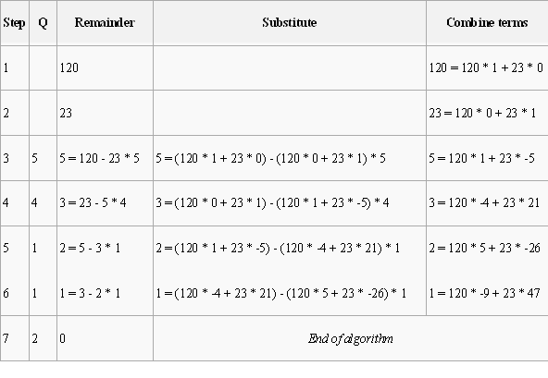
Compute the GCD of 120 and 23.

Slide 16
Fundamentals of Algorithmic Problem Solving

Slide 17
Fundamentals of Algorithmic Problem Solving
Algorithm = Procedural Solutions to Problem
NOT an answer, BUT rather specific instructions of getting answers.
Therefore, requires steps in designing and analyzing an algorithm

Slide 18
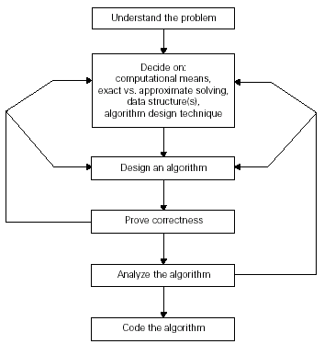
Algorithm Design & Analysis Process

Slide 19
Step 1: Understand the Problem
Before designing an algorithm - understand completely the problem given.
Read the problem’s description carefully and ask questions if you have any doubts about the problem,
Do a few small examples by hand, think about special cases, and ask questions again if needed.

Slide 20
Step 1: Understand the Problem
An input to an algorithm specifies an instance of the problem the algorithm solves.
It is very important to specify exactly the range of instances the algorithm needs to handle.
Failing which – the algorithm works correctly for some inputs , but crashes on some boundary values.
Remember that a correct algorithm is not one that works most of the time but one that works correctly for all legitimate inputs.

Slide 21
Step 2: Ascertaining the capabilities of a computational device
Algorithms designed to be executed on machines that executes intstructions one after another are called sequential algorithms.
Algorithms that take advantage of computers that can execute operations concurrently are called parallel algorithms.

Slide 22
Step 3: Choosing between Exact & Approximate Problem Solving
Solving the problem exactly - Exact algorithms
Solving the problem approximately - Approximation algorithms
Why approximation algorithms?
  1. Problems cannot be solved exactly.
  Eg. Extracting square roots, solving non-linear equations
  2. Available exact algorithms are unacceptably slow because of problem’s complexity
  Eg. Traveling Salesman Problem
  3. Approx. Algs can be a part of algorithms that solve the problem exactly.

Slide 23
Step 4: Deciding on Appropriate Data Structures
In the new world of object-oriented programming, data structures remain important for both design and analysis of algorithms.
However, we will assume a very basic data structure for now and concentrate on the algorithm side.

Slide 24
Step 5: Algorithm Design Techniques
An algorithm design technique (or “strategy” or “paradigm”) is a general approach to solving problems algorithmically that is applicable to a variety of problems from different areas of computing.
Eg. Brute force, Divide-and-Conquer, Transform-and-Conquer
Importance:
  Provide guidance for designing algorithms for new problems.
  To classify algorithms according to an underlying design idea.

Slide 25
Step 6: Methods of Specifying an Algorithm
Pseudocode, a mixture of a natural language and programming language-like constructs.
flowchart, a method of expressing an algorithm by a collection of connected geometric shapes containing descriptions of the algorithm’s steps.

Slide 26
Step 7: Proving an Algorithm’s Correctness
Prove algorithm’s correctness = prove that the algorithm yields a required result for every legitimate input in a finite amount of time.
For an approximation algorithm, correctness means to be able to show that the error produced by the algorithm does not exceed a predefined limit.

Slide 27
Step 8: Analyzing an Algorithm
1. Efficiency
  Time efficiency indicates how fast the algorithm runs.
  space efficiency indicates how much extra memory the algorithm needs.
2. Simplicity
3. Generality
  Design an algorithm for a problem posed in more general terms.
  Design an algorithm that can handle a range of inputs that is natural for the problem at hand.

Slide 28
Step 9: Coding the algorithm
More than implementation
Peril of incorrect & inefficient implementation
Require testing & debugging
Require code optimizing

Slide 29
Important Problem Types

Slide 30
Important Problem Types
Sorting
Searching
String processing
Graph problems
Combinatorial problems
Geometric problems
Numerical problems

Slide 31
Sorting
The sorting problem asks us to rearrange the items of a given list in ascending order.
we usually need to
  sort lists of numbers,
  characters from an alphabet,
  character strings,
  records similar to those maintained by schools about their students,
  libraries about their holdings,
  companies about their employees.

Slide 32
Searching
The searching problem deals with finding a given value, called a search key, in a given set (or a multiset, which permits several elements to have the same value).

Slide 33
String Processing
A string is a sequence of characters from an alphabet.
String of particular interest:
1. Text string – comprises letters, numbers, and special characters
2. Bit string – comprises zeros and ones
3. Gene sequence
Mainly string matching problem: searching for a given word in a text

Slide 34
Graph Problems
A graph can be thought of as a collection of points called vertices, some of which are connected by line segments called edges.
Used for modeling a wide variety of real-life applications.
Basic graph algorithms include:
1. Graph traversal algorithms - How can one visit all the points in a network?
2. Shortest-path algorithms - What is the best Introduction route between two cities?
3. Topological sorting for graphs with directed edges

Slide 35
Combinatorial Problems
combinatorial problems: problems that ask (explicitly or implicitly) to find a combinatorial object—such as a permutation, a combination, or a subset—that satisfies certain constraints and has some desired property (e.g., maximizes a value or minimizes a cost).
  1. Combinatorial grows extremely fast with problem size
2. No known algorithm solving most such problems exactly in an acceptable amount of time.

Slide 36
Geometric Problems
Geometric algorithms deal with geometric objects such as points, lines, and polygons.
2 class problems:
The closest pair problem: given n points in the plane, find the closest pair among them.
The convex hull problem asks to find the smallest convex polygon that would include all the points of a given set. If

Slide 37

Convex hull problem

Slide 38
Numerical Problems
Numerical problems, another large special area of applications, are problems that involve mathematical objects of continuous nature: solving equations and systems of equations, computing definite integrals, evaluating functions, and so on.

Slide 39
Fundamentals of Analysis of algorithm efficiency

Slide 40
Analysis of algorithms
Issues:
  correctness
  time efficiency
  space efficiency
  optimality
Approaches:
  theoretical analysis
  empirical analysis

Slide 41
Theoretical analysis of time efficiency
Time efficiency is analyzed by determining the number of repetitions of the basic operation as a function of input size
Basic operation: the operation that contributes the most towards the running time of the algorithm
T(n) ≈ c_{op}C(n)
input size
running time
execution time
for basic operation
or cost
Number of times basic operation is executed
Note: Different basic operations may cost differently!

Slide 42
Input size and basic operation examples
Problem | Input size measure | Basic operation
Searching for key in a list of n items | Number of list’s items, i.e. n | Key comparison
Multiplication of two matrices | Matrix dimensions or total number of elements | Multiplication of two numbers
Checking primality of a given integer n | n’size = number of digits (in binary representation) | Division
Typical graph problem | #vertices and/or edges | Visiting a vertex or traversing an edge

Slide 43
Empirical analysis of time efficiency
Select a specific (typical) sample of inputs
Use physical unit of time (e.g., milliseconds)
or
Count actual number of basic operation’s executions
Analyze the empirical data

Slide 44
Efficiencies
Worst Case Efficiency:
  Is its efficiency for the worst case input of size n, which is an input of size n for which the algorithm runs the longest among all possible inputs of that size
  C_{worst}(n)
Best-case efficiency:
  Is its efficiency for the worst case input of size n, which is an input of size n for which the algorithm runs the fastest among all possible inputs of that size
  C_{best}(n)

Slide 45
Amortized efficiency
  It applies not to a single run of an algorithm, but rather to a sequence of operations performed on the same data structure

Slide 46
Best-case, average-case, worst-case
For some algorithms, efficiency depends on form of input:
Worst case: C_{worst}(n) – maximum over inputs of size n
Best case: C_{best}(n) – minimum over inputs of size n
Average case: C_{avg}(n) – “average” over inputs of size n
  Number of times the basic operation will be executed on typical input
  NOT the average of worst and best case
  Expected number of basic operations considered as a random variable under some assumption about the probability distribution of all possible inputs. So, avg = expected under uniform distribution.

Slide 47
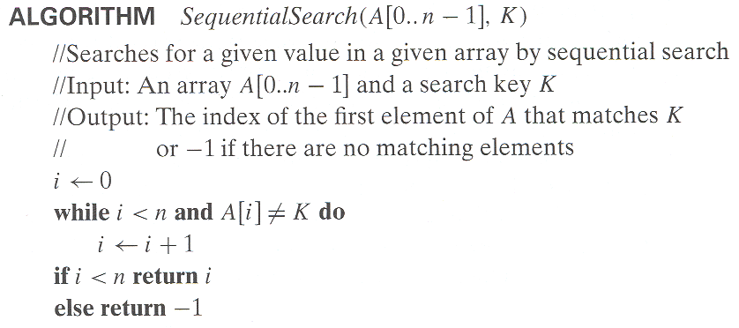
Example: Sequential search
Worst case
Best case
Average case
n key comparisons
1 comparisons
(n+1)/2, assuming K is in A

Slide 48
Types of formulas for basic operation’s count
Exact formula
e.g., C(n) = n(n-1)/2
Formula indicating order of growth with specific multiplicative constant
e.g., C(n) ≈ 0.5 n²
Formula indicating order of growth with unknown multiplicative constant
e.g., C(n) ≈ cn²

Slide 49
Order of growth
Most important: Order of growth within a constant multiple as n→∞
Example:
  How much faster will algorithm run on computer that is twice as fast?
  How much longer does it take to solve problem of double input size?
Notes:
Example: cn²
how much faster on twice as fast computer? (2)
how much longer for 2n? (4)

Slide 50
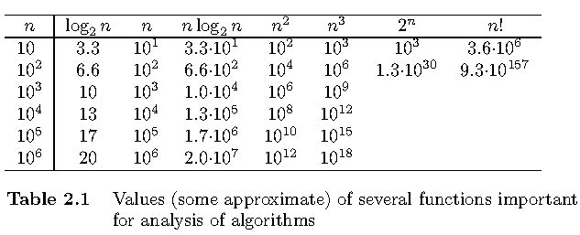
Values of some important functions as n → ∞

Slide 51
Asymptotic Notations
O (Big-Oh)-notation
Ω (Big-Omega) -notation
Θ (Big-Theta) -notation

Slide 52
Asymptotic order of growth
A way of comparing functions that ignores constant factors and small input sizes (because?)
O(g(n)): class of functions f(n) that grow no faster than g(n)
Θ(g(n)): class of functions f(n) that grow at same rate as g(n)
Ω(g(n)): class of functions f(n) that grow at least as fast as g(n)

Slide 53
O-notation
Definition: A function t(n) is said to be in O(g(n)), denoted t(n) ∈ O(g(n)) is bounded above by some constant multiple of g(n) for all large n, i.e., there exist positive constant c and non-negative integer n₀ such that
f(n) ≤ c g(n) for every n ≥ n₀
Notes:
Examples:
10n is O(n²)
since 10n ≤ 10n² for n ≥ 1 or 10n ≤ n² for n ≥ 10
c n₀
5n+20 is O(10n)
since 5n+20 ≤ 10 n for n ≥ 4
c n₀

Slide 54
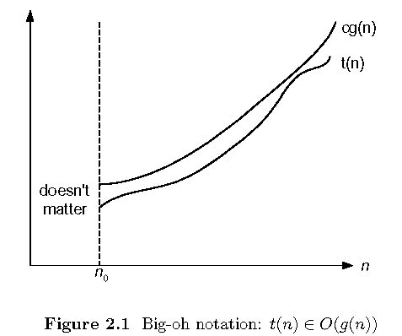
Big-oh

Slide 55
Ω-notation
Formal definition
  A function t(n) is said to be in Ω(g(n)), denoted t(n) ∈ Ω(g(n)), if t(n) is bounded below by some constant multiple of g(n) for all large n, i.e., if there exist some positive constant c and some nonnegative integer n₀ such that
  t(n) ≥ cg(n) for all n ≥ n₀

Slide 56
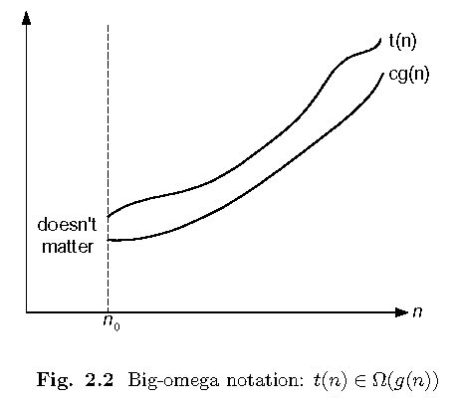
Big-omega

Slide 57
Θ-notation
Formal definition
  A function t(n) is said to be in Θ(g(n)), denoted t(n) ∈ Θ(g(n)), if t(n) is bounded both above and below by some positive constant multiples of g(n) for all large n, i.e., if there exist some positive constant c₁ and c₂ and some nonnegative integer n₀ such that
  c₂ g(n) ≤ t(n) ≤ c₁ g(n) for all n ≥ n₀

Slide 58
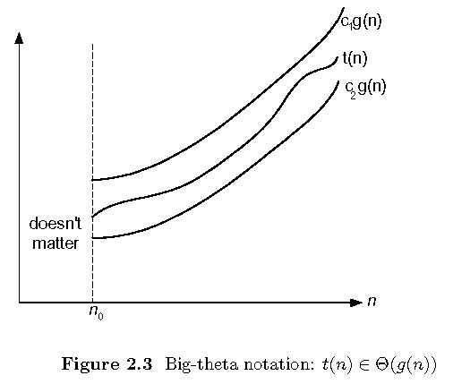
Big-theta

Slide 59
Theorem
If t₁(n) ∈ O(g₁(n)) and t₂(n) ∈ O(g₂(n)), then
t₁(n) + t₂(n) ∈ O(max{g₁(n), g₂(n)}).
  The analogous assertions are true for the Ω-notation and Θ-notation.
Proof. There exist constants c1, c2, n1, n2 such that
t1(n) ≤ c1*g1(n), for all n ≥ n1
t2(n) ≤ c2*g2(n), for all n ≥ n2
Define c3 = c1 + c2 and n3 = max{n1,n2}. Then
t1(n) + t2(n) ≤ c3*max{g1(n), g2(n)}, for all n ≥ n3

Slide 60
Some properties of asymptotic order of growth
f(n) ∈ O(f(n))
f(n) ∈ O(g(n)) iff g(n) ∈Ω(f(n))
If f (n) ∈ O(g (n)) and g(n) ∈ O(h(n)) , then f(n) ∈ O(h(n))
Note similarity with a ≤ b
If f₁(n) ∈ O(g₁(n)) and f₂(n) ∈ O(g₂(n)) , then
f₁(n) + f₂(n) ∈ O(max{g₁(n), g₂(n)})
Also, Σ_{1≤i≤n} Θ(f(i)) = Θ (Σ_{1≤i≤n} f(i))

Slide 61
Establishing order of growth using limits
0 order of growth of T(n) < order of growth of g(n)
lim T(n)/g(n) =
c > 0 order of growth of T(n) = order of growth of g(n)
n→∞
∞ order of growth of T(n) > order of growth of g(n)

Slide 62
L’Hôpital’s rule and Stirling’s formula
L’Hôpital’s rule: If lim_{n→∞} f(n) = lim_{n→∞} g(n) = ∞ and
the derivatives f´, g´ exist, then
Stirling’s formula: n! ≈ (2πn)^{1/2} (n/e)^{n}
f(n)
g(n)
f ´(n)
g ´(n)
lim
n→∞
=
lim
n→∞
Example: log n vs. n
Example: 2^{n} vs. n!

Slide 63
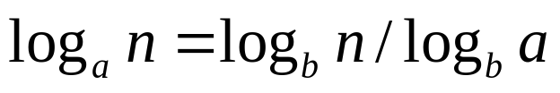
Orders of growth of some important functions
All logarithmic functions log_{a} n belong to the same class
Θ(log n) no matter what the logarithm’s base a > 1 is
because
All polynomials of the same degree k belong to the same class:
a_{k}n^{k} + a_{k-1}n^{k-1} + … + a₀ ∈ Θ(n^{k})
Exponential functions a^{n} have different orders of growth for different a’s
order log n < order n^{α} (α>0) < order a^{n} < order n! < order n^{n}

Slide 64
Basic asymptotic efficiency classes
1 | constant
log n | logarithmic
n | linear
n log n | n-log-n
n² | quadratic
n³ | cubic
2^{n} | exponential
n! | factorial

Slide 65
Plan for analyzing nonrecursive algorithms
General Plan for Analysis
Decide on parameter n indicating input size
Identify algorithm’s basiyc operation
Determine worst, average, and best cases for input of size n
Set up a sum for the number of times the basic operation is executed
Simplify the sum using standard formulas and rules (see Appendix A)

Slide 66
Useful summation formulas and rules
Σ_{l≤i≤n}1 = 1+1+…+1 = n - l + 1
In particular, Σ_{l≤i≤n}1 = n - 1 + 1 = n ∈ Θ(n)
Σ_{1≤i≤n} i = 1+2+…+n = n(n+1)/2 ≈ n²/2 ∈ Θ(n²)
Σ_{1≤i≤n} i² = 1²+2²+…+n² = n(n+1)(2n+1)/6 ≈ n³/3 ∈ Θ(n³)
Σ_{0≤i≤n} a^{i} = 1 + a +…+ a^{n} = (a^{n+1} - 1)/(a - 1) for any a ≠ 1
In particular, Σ_{0≤i≤n} 2^{i} = 2⁰ + 2¹ +…+ 2^{n} = 2^{n+1} - 1 ∈ Θ(2^{n} )
Σ(a_{i} ± b_{i} ) = Σa_{i} ± Σb_{i} Σca_{i} = cΣa_{i} Σ_{l≤i≤u}a_{i} = Σ_{l≤i≤m}a_{i} + Σ_{m+1≤i≤u}a_{i}

Slide 67
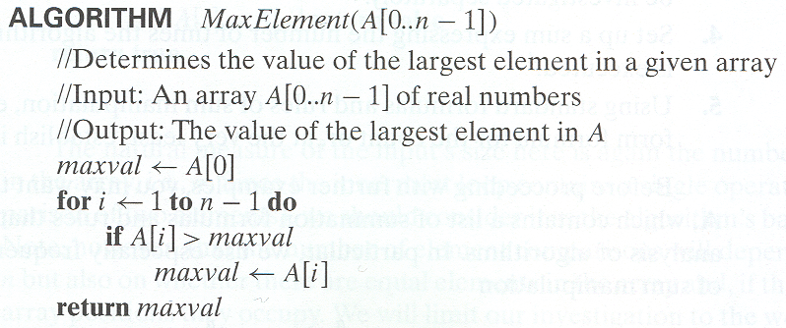
Example 1: Maximum element
T(n) = Σ1≤i≤n-1 1 = n-1 = Θ(n) comparisons

Slide 68
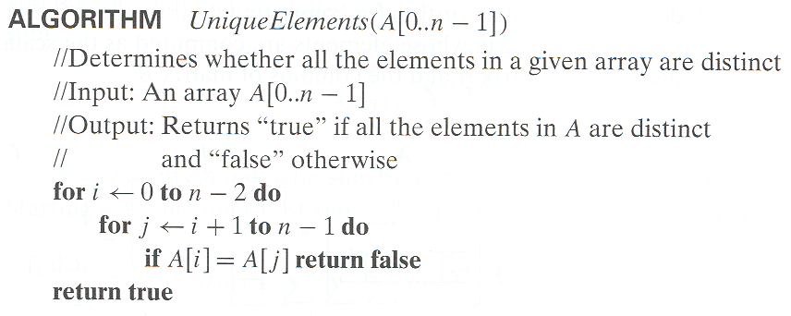

Example 2: Element uniqueness problem
T(n) = Σ0≤i≤n-2 (Σi+1≤j≤n-1 1)
= Σ0≤i≤n-2 n-i-1 = (n-1+1)(n-1)/2
= Θ( ) comparisons

Slide 69
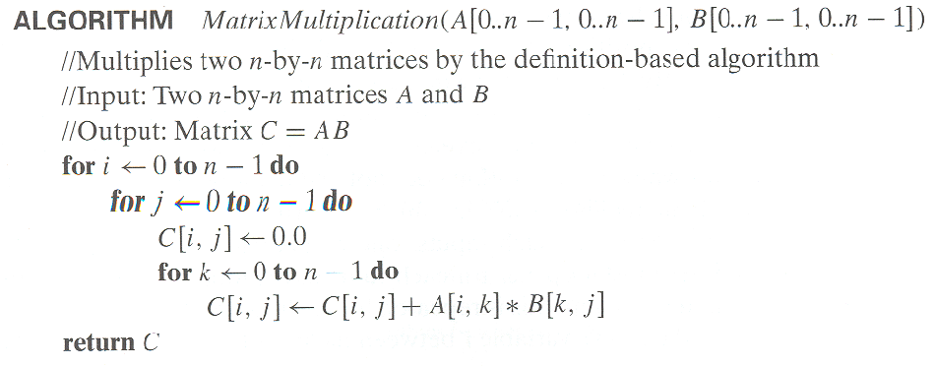


Example 3: Matrix multiplication
T(n) = Σ0≤i≤n-1 Σ0≤i≤n-1 n
= Σ0≤i≤n-1 Θ( )
= Θ( ) multiplications

Slide 70
Example 4: Gaussian elimination
Algorithm GaussianElimination(A[0..n-1,0..n])
//Implements Gaussian elimination on an n-by-(n+1) matrix A
for i ← 0 to n - 2 do
for j ← i + 1 to n - 1 do
for k ← i to n do
A[j,k] ← A[j,k] - A[i,k] ∗ A[j,i] / A[i,i]
Find the efficiency class and a constant factor improvement.
for i ← 0 to n - 2 do
for j ← i + 1 to n - 1 do
B ← A[j,i] / A[i,i]
for k ← i to n do
A[j,k] ← A[j,k] – A[i,k] * B

Slide 71
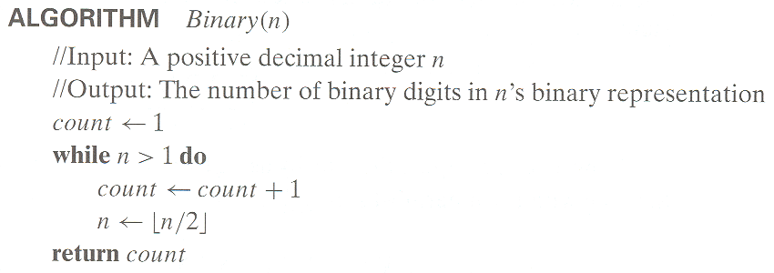
Example 5: Counting binary digits

Slide 72
Plan for Analysis of Recursive Algorithms
Decide on a parameter indicating an input’s size.
Identify the algorithm’s basic operation.
Check whether the number of times the basic op. is executed may vary on different inputs of the same size. (If it may, the worst, average, and best cases must be investigated separately.)
Set up a recurrence relation with an appropriate initial condition expressing the number of times the basic op. is executed.
Solve the recurrence (or, at the very least, establish its solution’s order of growth) by backward substitutions or another method.

Slide 73
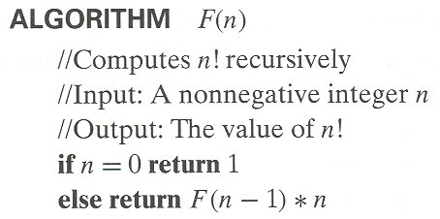
Example 1: Recursive evaluation of n!
Definition: n ! = 1 ∗ 2 ∗ … ∗(n-1) ∗ n for n ≥ 1 and 0! = 1
Recursive definition of n!: F(n) = F(n-1) ∗ n for n ≥ 1 and
F(0) = 1
Size:
Basic operation:
Recurrence relation:
n
multiplication
M(n) = M(n-1) + 1
M(0) = 0
Notes:
Note the difference between the two recurrences. Students often confuse these!
F(n) = F(n-1) n
F(0) = 1
for the values of n!
------------
M(n) =M(n-1) + 1
M(0) = 0
for the number of multiplications made by this algorithm

Slide 74
Solving the recurrence for M(n)
M(n) = M(n-1) + 1, M(0) = 0
M(n) = M(n-1) + 1
= (M(n-2) + 1) + 1 = M(n-2) + 2
= (M(n-3) + 1) + 2 = M(n-3) + 3
…
= M(n-i) + i
= M(0) + n
= n
The method is called backward substitution.

Slide 75
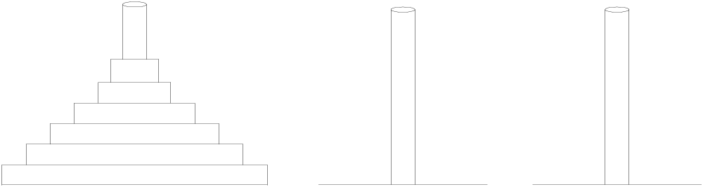
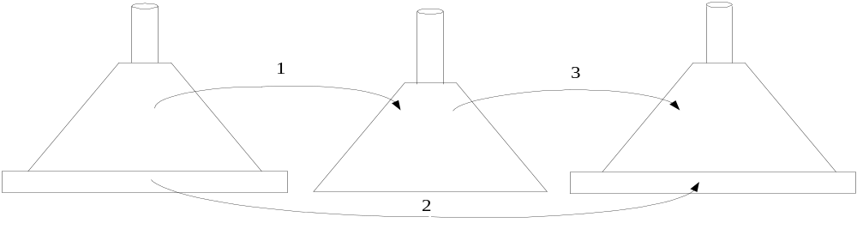
Example 2: The Tower of Hanoi Puzzle
Recurrence for number of moves:
M(n) = 2M(n-1) + 1

Slide 76
Solving recurrence for number of moves
M(n) = 2M(n-1) + 1, M(1) = 1
M(n) = 2M(n-1) + 1
= 2(2M(n-2) + 1) + 1 = 2^2*M(n-2) + 2^1 + 2^0
= 2^2*(2M(n-3) + 1) + 2^1 + 2^0
= 2^3*M(n-3) + 2^2 + 2^1 + 2^0
= …
= 2^(n-1)*M(1) + 2^(n-2) + … + 2^1 + 2^0
= 2^(n-1) + 2^(n-2) + … + 2^1 + 2^0
= 2^n - 1

Slide 77
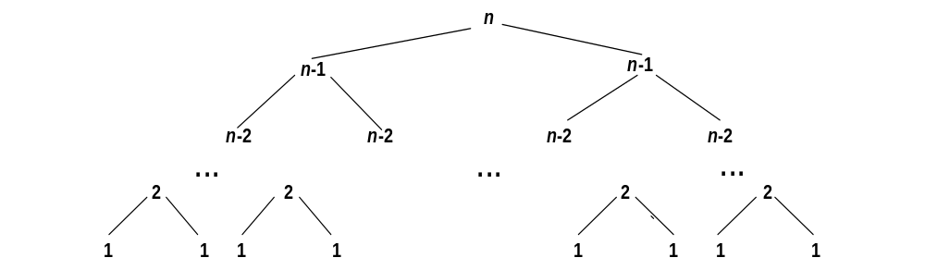
Tree of calls for the Tower of Hanoi Puzzle

Slide 78
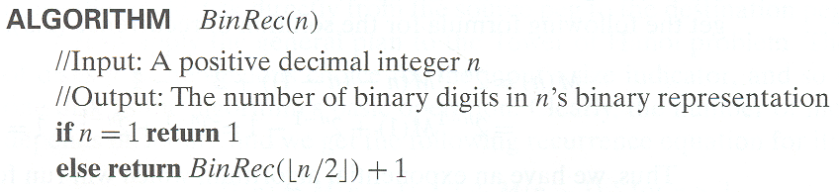
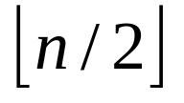
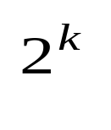
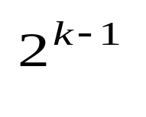
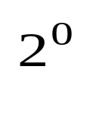
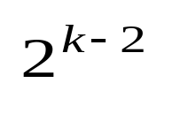
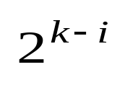
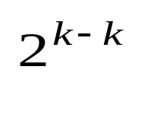
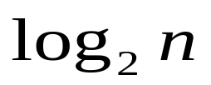
Example 3: Counting #bits
A(n) = A( ) + 1, A(1) = 0
A( ) = A( ) + 1, A( ) = 1 (using the Smoothness Rule)
= (A( ) + 1) + 1 = A( ) + 2
= A( ) + i
= A( ) + k = k + 0
=

